Slide 1
Hot Topics in U.S. Sanctions: What Cypriot Businesses Need to Know
Presentation by:
Barnes & Thornburg LLP

Slide 2
This is a public, non-confidential forum so please do not provide any confidential information.
Questions asked will be answered in the hypothetical.
Information provided should not be construed as legal analysis, advice, or opinion on any specific facts or circumstances. This seminar, discussion, and question and answer session is not intended to specifically address or answer any specific legal issues. Please direct specific legal issues to your attorney for further consideration.

Slide 3
How U.S Sanctions Impact Cypriot Companies
General Overview of U.S. Export Controls and Sanctions Laws
OFAC Sanctions Primer
Implementing Compliance Programs
Screening and Due Diligence

Slide 4
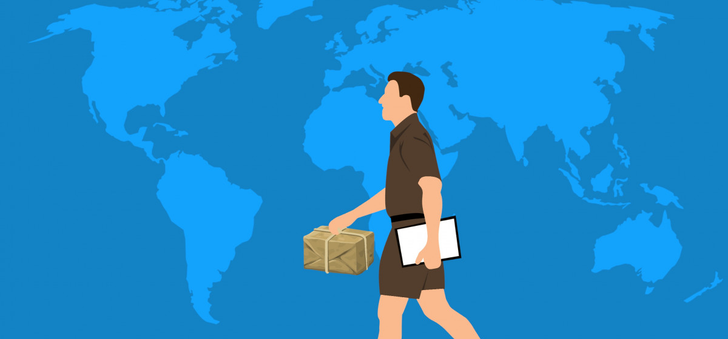
General Overview of U.s. Export Controls & Sanctions Laws

Slide 5
Understand why the U.S. maintains export controls and sanctions laws and which agencies implement and enforce them.
Introduce U.S. Export policy, U.S. Sanctions, Embargoes and other trade restrictions
Overview of Governing Laws, Regulations, & Regulating Agencies

Slide 6
Introduction to Export Control Laws
U.S. Export Control Policy: Restricts the Export or Re-export of Goods, Services and Technology for the Purposes of:
PROTECTING NATIONAL SECURITY
IMPLEMENTING FOREIGN POLICY, E.G. MAINTAINING REGIONAL STABILITY
PREVENTING THE PROLIFERATION OF WEAPONS OF MASS DESTRUCTION (WMD)
PREVENTING TERRORIST ACTIVITIES

Slide 7
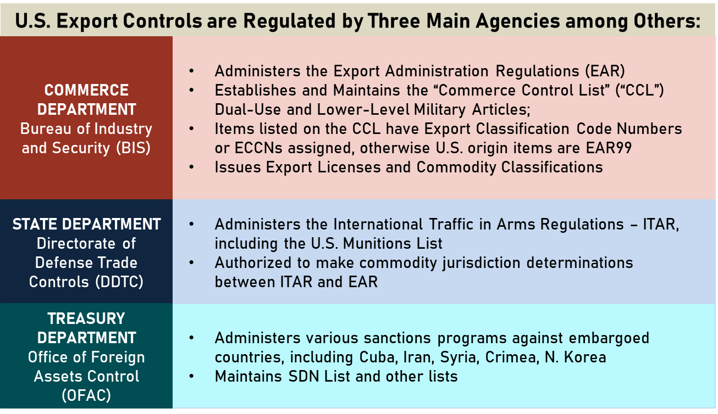
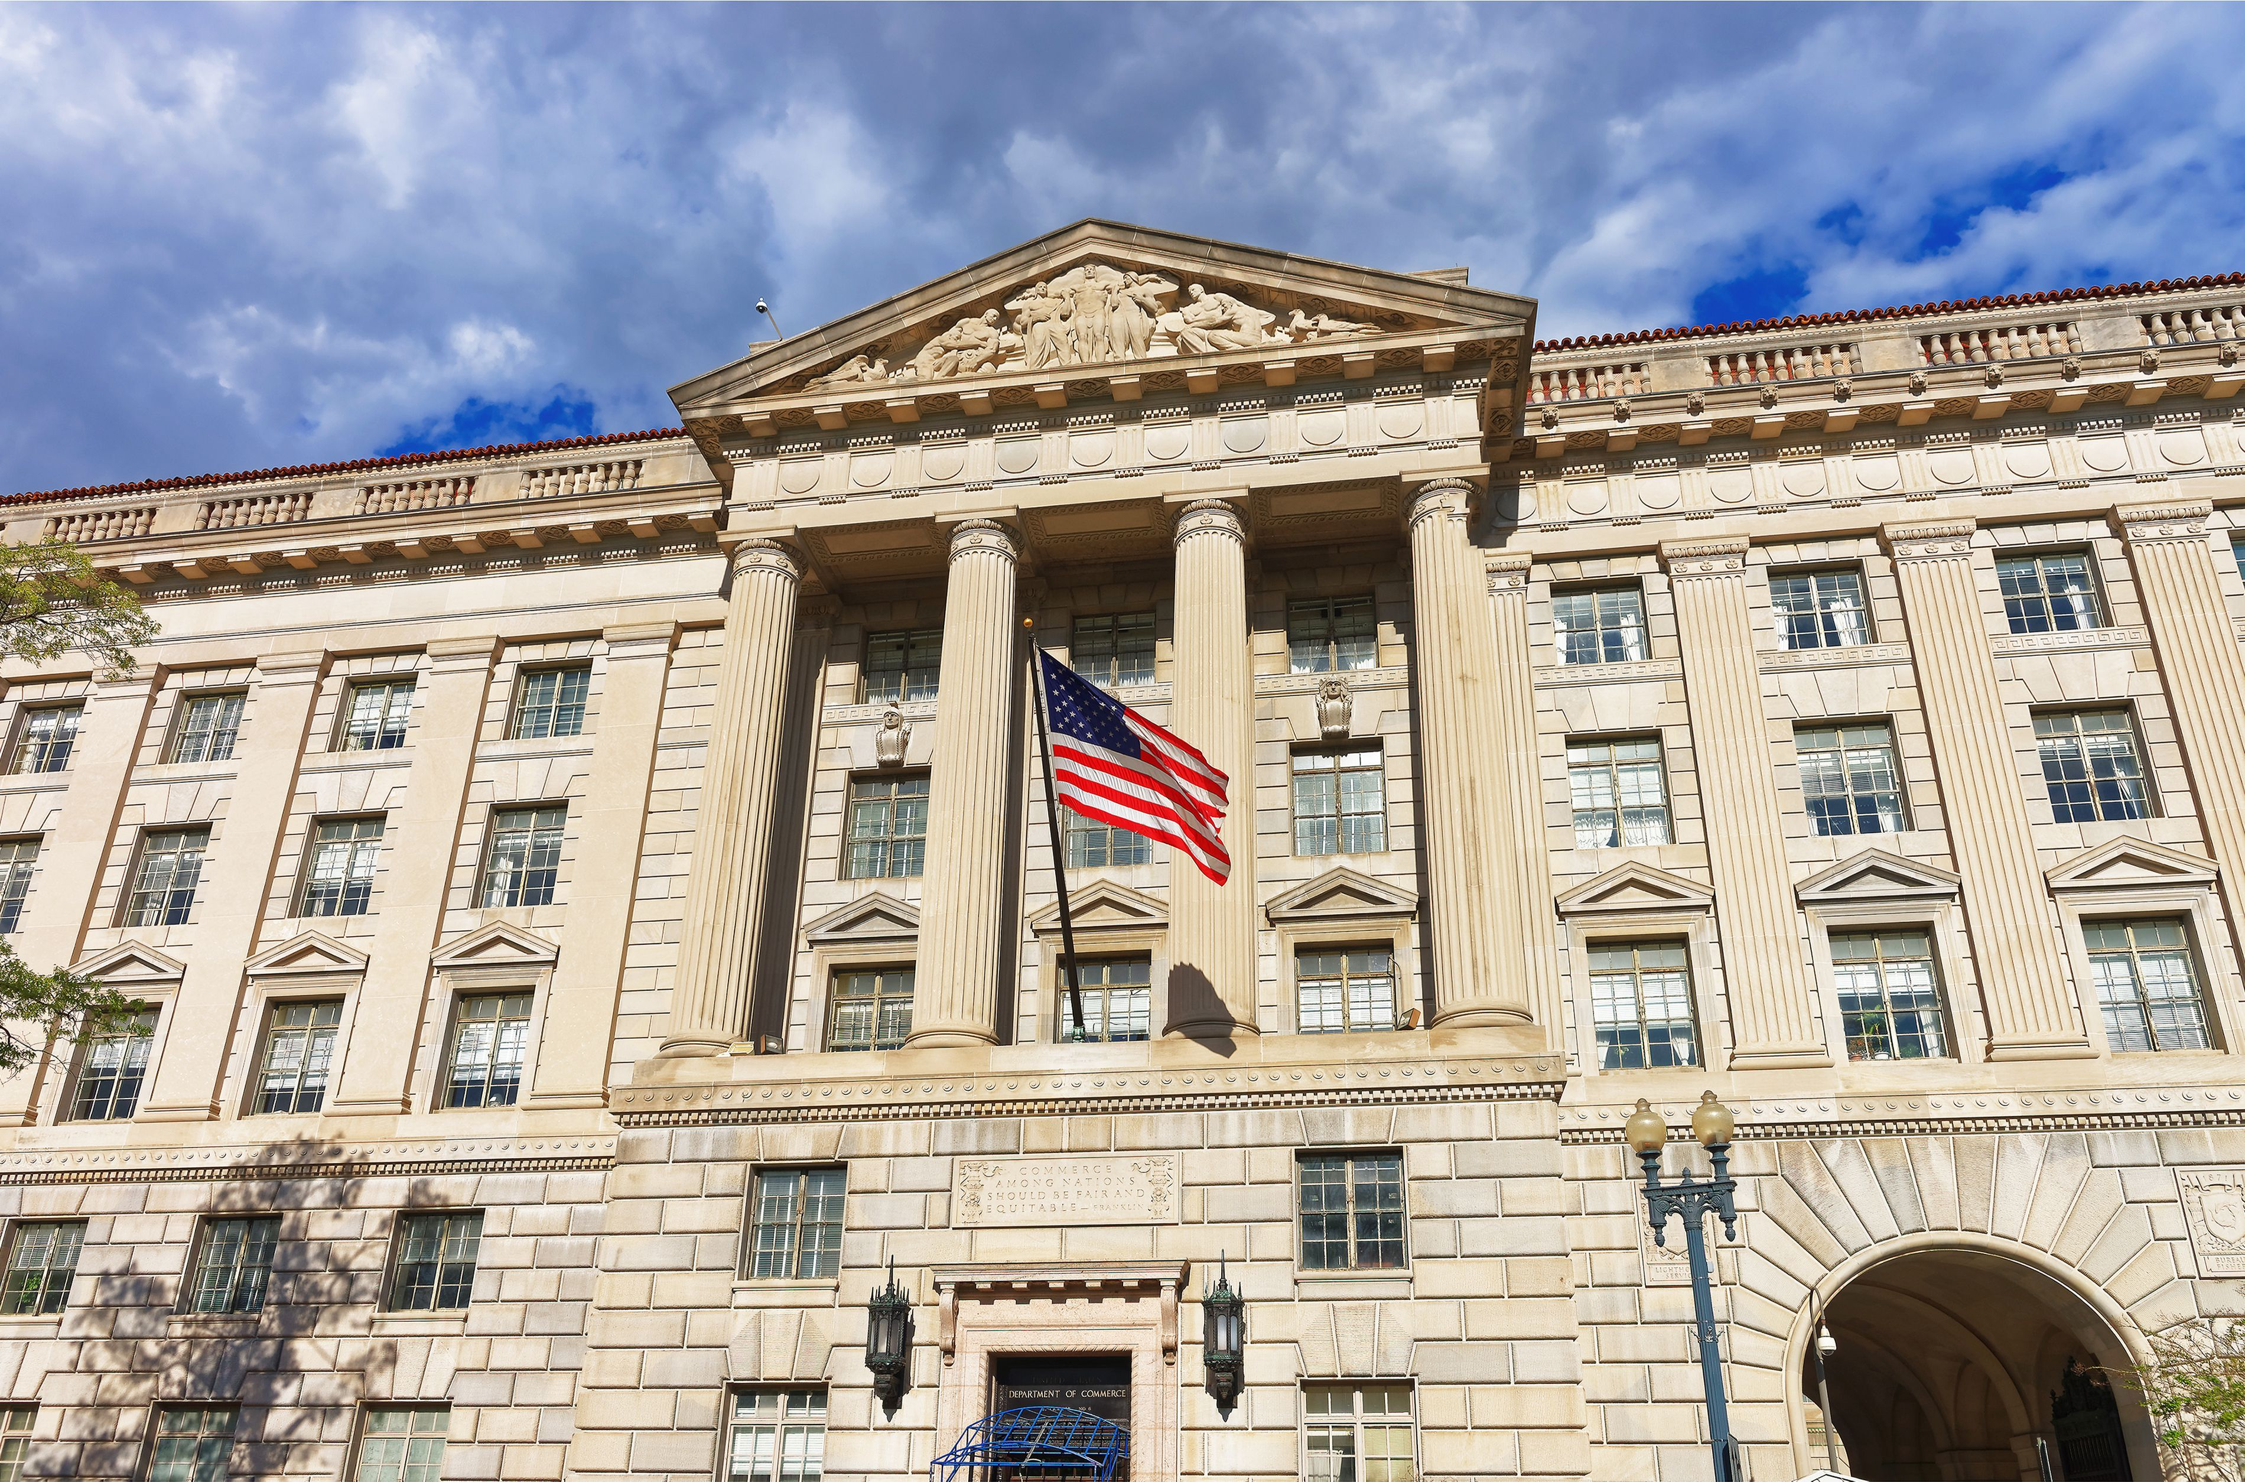
REGULATING AGENCIES
What are the Regulating Agencies?

Slide 8
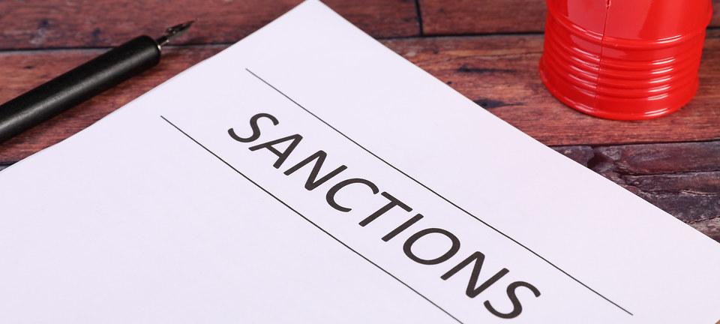
U.S. SANCTIONS
Notes:
8

Slide 9
LEARNING OBJECTIVE
Identify U.S. sanctions concerns and how they interact with U.S. export controls
INTRODUCTION
KEY CONCEPTS
EMBARGOED DESTINATIONS
KNOWLEDGE CHECK
LIST-BASED AND OTHER OFAC SANCTIONS
KNOWLEDGE CHECK
ADDITIONAL OFAC CONCERNS
PUTTING IT ALL TOGETHER – THE RUSSIA EXAMPLE

Slide 10
Introduction to U.S. Sanctions
U.S. maintains Sanctions, Embargoes and Other Restrictions
Certain “persons” (e.g., entities and individuals) are subject to trade sanctions, embargoes, and other restrictions under US law. Depending on the regulation at issue, these restrictions can apply to both domestic and foreign transactions.
Certain countries are subject to either comprehensive sanctions or targeted sanctions.
Comprehensive sanctions prohibit virtually ALL exports/imports, services, and other transactions without a license or other US Government authorization.
Targeted sanctions are prohibitions on trade in specified goods, technologies, or services with specific persons/governments.

Slide 11
Introduction to U.S. Sanctions
Prohibited Destinations: Embargoed or Restricted Countries
Comprehensive Embargoes | Significant Restrictions
Generally prohibit all trade (goods, technology, services) and financial transactions by U.S. persons with: Cuba Iran Syria North Korea Crimea and So-Called Donetsk, Luhansk Regions of Ukraine | Significant Restrictions on Trade With the Following Countries: Russia Belarus Venezuela Burma/Myanmar

Slide 12
U.S. SANCTIONS PRIMER
Introduction
U.S. sanctions laws complement U.S. export controls in implementing foreign policy objectives. This results in frequent and rapid changes.
Primarily implemented and enforced by OFAC, but other agencies such as the State Department can be involved.
Sanctions restrictions can apply to both domestic and foreign transactions, depending on the circumstances.
Each U.S. sanctions program is unique, not only in their restrictions, but also in general licenses and other authorizations.
Potential for overlap with EAR/ITAR. Do you need a license from more than one agency?

Slide 13
U.S. SANCTIONS PRIMER
Key Concepts
TERM/CONCEPT | DESCRIPTION
PRIMARY SANCTIONS | Generally function by identifying a target for sanctions, such as an individual, entity, or a country, and restricting activities with the target by U.S. persons or involving U.S. jurisdiction (i.e., U.S. nexus).
U.S. PERSON | Generally, under U.S. sanctions laws, U.S. persons include: Any United States citizen or permanent resident alien, Any entity organized under the laws of the United States or any jurisdiction within the United States (including foreign branches), or Any person in the United States (even temporarily). Note that the Cuba and Iran embargoes can also apply to foreign subsidiaries of U.S. entities.
U.S. NEXUS | Potential U.S. nexuses for activities taking place outside the U.S.: U.S. citizens or permanent resident aliens working abroad U.S. person “facilitation” (e.g., U.S. sub/affiliate) USD payments (clearing through U.S. bank) Exports from U.S. Conspiracies/”causing” a violation

Slide 14
U.S. SANCTIONS PRIMER
Key Concepts
TERM/CONCEPT | DESCRIPTION
LIST OF SPECIALLY DESIGNATED NATIONALS AND OTHER BLOCKED PARTIES (SDN LIST) | A “blacklist” of persons (e.g., individuals, entities, vessels) with which U.S. persons may have no unlicensed dealings and whose property and interests in property in the U.S. are “blocked” (i.e, frozen). Primarily maintained by OFAC.
GENERAL LICENSE | License authorizing activities that would otherwise be prohibited under U.S. sanctions and upon which anyone may rely, i.e., generally available to the public. Must meet and comply with all strict terms of the license. Note: may be within the regulations or published to OFAC’s website
SPECIFIC LICENSE | A written document issued by OFAC to a particular person or entity in response to a written license application, authorizing a particular transaction that would otherwise be prohibited under U.S. sanctions. Must comply with any conditions.

Slide 15
U.S. Sanctions Do Not Only Affect U.S. Companies
Any U.S. nexus could trigger U.S. sanctions jurisdiction
Most U.S. sanctions apply to “U.S. persons,” wherever located, or activities in the U.S.
“U.S. persons”
U.S. citizens and lawful permanent residents
Entities organized under the laws of the U.S. or any jurisdiction within the U.S. (including foreign branches)
Any person in the United States.
Cuba and Iran regimes also extend to certain foreign entities owned or controlled by U.S. companies
Facilitation, conspiracies, evasion, “causing” a violation
“Sanctionable” Conduct by Non-U.S. Persons
Where no U.S. nexus, non-U.S. persons can be sanctioned for engaging in certain activities, such as:
Providing material support, goods, or services to persons sanctioned by U.S.
Involvement in targeted activities, e.g., responsible for activities that undermine democratic processes

Slide 16
U.S. SANCTIONS PRIMER
List-Based and Other OFAC Sanctions
LIST-BASED SANCTIONS: OFAC designates persons (e.g., individuals, entities, vessels) to a sanctions list pursuant to certain criteria established in Executive Orders or other authorities
E.g., persons determined to have engaged in actions or policies that undermine democratic processes or institutions in Burma
Types of Lists
SDN List: U.S. persons restricted from all activities with the designated person.
50% rule: entities owned by a party on the SDN List are also considered blocked persons
Non-SDN Lists: U.S. persons restricted from certain activities with the designated person.
E.g., dealings in debt or securities of certain entities.

Slide 17
U.S. SANCTIONS PRIMER
List-Based and Other OFAC Sanctions
U.S. Persons also restricted from certain types of dealings with “Non–SDN’s”
Foreign Sanctions Evaders
Sectoral Sanctions Identifications
Palestinian Legislative Council
Foreign Financial Institutions subject to Part 561 - Iran
Non-SDN Iranian Sanctions Act
List of Foreign Financial Institutions Subject to Correspondent Account or Payable-Through Account Sanctions Non-SDN Menu-Based Sanctions List
Chinese Military Companies
Harmful Foreign Activities of Russia
http://www.treasury.gov/resource-center/sanctions/SDN-List/Pages/consolidated.aspx

Slide 18
U.S. SANCTIONS PRIMER
Other OFAC Programs
Conflict Diamonds ​Countering America's Adversaries Through Sanctions Act-Related Sanctions Cyber-Related Foreign Interference in US Elections Hostages and Wrongfully Detained U.S. Nationals International Criminal Court | Magnitsky and Global Magnitsky Sanctions Narcotics Traffickers Non-proliferation Oligarchs Terrorists and Global Terrorists Transnational Criminal Organizations https://www.treasury.gov/resource-center/sanctions/SDN-List/Pages/program_tags.aspx

Slide 19
U.S. SANCTIONS PRIMER
List-Based and Other OFAC Sanctions
Other Types of Sanctions
OFAC maintains other types of sanctions beyond comprehensive embargoes and list-based sanctions, such as:
Venezuela
Government of Venezuela treated as “blocked” person
Includes agencies/controlled entities, even if not named to SDN List
Russia
Variety of provisions, such as new investment ban (see later discussion)

Slide 20
U.S. SANCTIONS PRIMER
Additional OFAC Concerns
U.S. Person Facilitation
Can’t do indirectly what you may not do directly
U.S. Persons also can’t “facilitate” prohibited activities
Can’t be involved in purchasing, selling, transporting, swapping, brokering, approving, financing, facilitating, or guaranteeing sanctioned business
E.g., receiving Iran-related inquiry and forwarding business opportunity to foreign parent

Slide 21
U.S. SANCTIONS PRIMER
Additional OFAC Concerns
Secondary sanctions are generally directed toward non-U.S. persons for specified conduct occurring outside of U.S. jurisdiction. Such conduct is sanctionable and non-U.S. persons who engage in such conduct may themselves be sanctioned by the United States.
In effect, these secondary sanctions often force a choice between doing business with Iran and doing business with the United States.
E.g., transactions supporting Iran’s automotive sector subject to secondary sanctions
Could affect foreign parent companies and foreign affiliates

Slide 22
Increasing Complexity dealing with Russia
Examples of Unique Targeted Restrictions for Russia
Ban on U.S. Person Services to Russia (Wherever Located, Even in EU) | Accounting, trust and corporation formation, management consulting, quantum computing, architecture, engineering
License Requirement for U.S. Variety of Items “Subject to the EAR” | Includes even many low-level consumer goods and “luxury goods” (vehicles, apparel, art, jewelry, etc.) Includes high-tech items such as navigation/avionics, encryption items/telecom, electronics Unique rules concerning U.S. content and technology/software used in production

Slide 23
Increasing Complexity dealing with Russia
Ban on New Investments in Russia
Prohibits any new investment in Russia by a U.S. person, wherever located
“Investment” defined as commitment of capital or other assets for the purpose of generating returns or appreciation.
“New” means commitments made after April 6, 2022, and includes a party exercising its rights under an agreement made prior to the Order
Not limited by industry sector

Slide 24
EAR AND OFAC – WHAT COUNTRIES TO WATCH
Putting It All Together – The Russia Example
Not Comprehensively Embargoed But Multiple Relevant Programs to Review
Ukraine-/Russia-Related Sanctions Program
Russian Harmful Foreign Activities Sanctions Program
Magnitsky Sanctions
Countering America's Adversaries Through Sanctions Act of 2017 (CAATSA)
Russian persons may also be subject to sanctions under other sanctions programs
Nearly Every Type of Sanction Implicated
Regional Embargoes
Crimea and the So-Called Donetsk People’s Republic and Luhansk People’s Republic
List-Based Sanctions
SDNs - 50 Percent Rule concerns: many oligarchs with extensive ownership interests inside and outside of Russia
Non-SDNs - Sectoral Sanctions Identifications (SSI) List

Slide 25
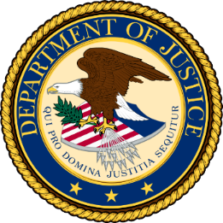
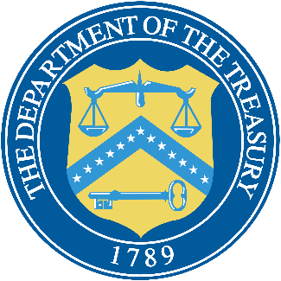
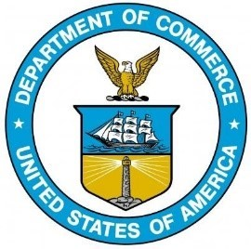
Expect Significant Enforcement Activity (Particularly for Russia)
U.S. Treasury and Department of Justice (DOJ) join Russian Elites, Proxies, and Oligarchs (REPO) Multilateral Task Force
Australia, Canada, Germany, France, Italy, Japan, UK, and European Commission
DOJ Task Force KleptoCapture to enforce sanctions and export restrictions

Slide 26
Expect Significant Enforcement Activity (Particularly for Russia)
Civil Monetary Penalties
OFAC-Administered Regulations:
Up to $356,579 per violation or an amount twice the amount of the transaction
EAR
Up to $353,534 per violation or an amount twice the amount of the transaction
Criminal Penalties
Up to $1 Million, 20 Years in Prison, or both
Administrative Penalties
Detention and seizure of merchandise
Loss of export privileges – “denied person”
Threat of Secondary Sanctions on non-U.S. parties

Slide 27
Expect Significant Enforcement Activity (Particularly for Russia)
“Cracking Down on Third-Party Intermediaries Used to Evade Russia-Related Sanctions and Export Controls.” U.S. government guidance warns companies to be vigilant against sanctions and export controls evasion attempts, and identified common red flags when dealing with intermediaries, e.g.:
Use of corporate vehicles such as shell companies to obscure ownership, source of funds, and/or countries involved
Payment coming from a third-party not listed on the end-user forms
IP addresses unrelated to a customer’s reported location
Use of personal email accounts instead of company email addresses; transactions involving entities with little or no web presence
Transactions involving a change in shipments or payments that were previously scheduled for Russia or Belarus

Slide 28
Sanctioned party: de-listing
Generally process exists
File petition with agency
Appeals rarely successful
Formal applications not often successful
Whole of government process
Possible approaches to facilitate
Re-framing the narrative
U.S. government cooperation

Slide 29
Considerations for dealing with sanctioned parties
Risk?
Case-by-case analysis
Scrutinize sanctions regime/type
Will U.S. care?
U.S. nexus
Deal regularly with U.S. or in U.S. dollars
Available actions?
Do nothing
Freeze
Continue on “as is”
License?
Financial resolution

Slide 30
Examples of OFAC Enforcement Cases
Bank of China (UK) Limited (2021)
OFAC Sudan violations
111 commercial transactions through the US financial system, on behalf of parties in Sudan, totaling $40,599,184
Filed a voluntary self-disclosure
Considered a “non-egregious case”
Paid a $2.3 million fine

Slide 31
Examples of OFAC Enforcement Cases
Schlumberger Oilfield Holdings Ltd. (2013)
Key Facts from Statement of Offense:
Facilitated trade with Iran and Sudan (when Sudan was still subject to a U.S. embargo).
“Although it was lawful for SOHL, a non-U.S. entity, to operate in Iran and Sudan under certain circumstances . . . Schlumberger failed to train its employees adequately to ensure that all company U.S. persons, including non-U.S. citizens who resided in the U.S. . . . fully complied with Schlumberger's policies and procedures assuring compliance with U.S. economic sanctions.”
“[M]any of the . . . employees located in the United States were non-U.S. citizens with little or no prior exposure to U.S. sanctions laws but nonetheless were U.S. persons [under U.S. sanctions laws].”
Penalty: $232 million

Slide 32
Joint Agency Enforcement
Yantai Jereh Oilfield Services Group Co. Ltd. – 2018
BIS and OFAC joint enforcement effort
China-based Yantai Jereh bought and sold oilfield equipment (spare parts, coiled tubing string, pump sets) with intent to export to Iran via China and UAE
BIS jurisdiction: equipment was subject to the EAR and prohibited for export to Iran
OFAC jurisdiction: prohibited exportation of U.S.-origin goods to Iran
Concealed ultimate destination involving separate China-based trading company; false statements made to BIS
BIS penalty: $600,000, 5-year probationary period
OFAC penalty: $2.8 million civil penalty; OFAC considered this an “egregious case”

Slide 33
IMPLEMENTING COMPLIANCE PROGRAMS

Slide 34
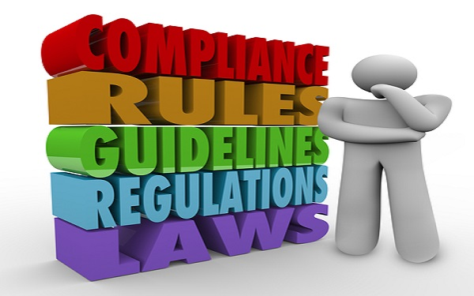
Compliance Programs
Enforcement Agent’s first words: “Let’s see a copy of your compliance program”
Mitigating factor for non-compliance
Lessens risk in export transactions
Provides a roadmap of the processing flow to ensure consistent export compliance
Provides personnel with tools and procedures to help them perform their functions accurately
Improve accountability for export control tasks by identifying responsible persons

Slide 35
Compliance Programs
Implement a Sanctions/Export Controls Management Program
Guidance available on DDTC, BIS and OFAC websites:
https://www.pmddtc.state.gov/sys_attachment.do?sys_id=1216c09a1b671d14d1f1ea02f54bcb25
https://www.bis.doc.gov/index.php/documents/pdfs/1641-ecp/file
https://home.treasury.gov/system/files/126/framework_ofac_cc.pdf
Each company differs in scope with respect to its export activities and general business
Should be tailored to conform to the company’s specific business and organizational structure

Slide 36
Compliance Programs
Factors to Consider
Each company differs in scope with respect to its general business
Basic formats should be tailored to conform to the company’s specific business and organizational structure
Notes:
36

Slide 37
“De-risking” Makes Still Lawful Business Difficult
U.S. and non-U.S. financial institutions will tend to over-comply
Why? Many OFAC enforcement actions have targeted major financial insitutions
OFAC: “De-risking occurs when financial institutions terminate or restrict business relationships indiscriminately with broad categories of customers rather than analyzing and managing the risk of those customers.”
U.S. Treasury Department’s 2023 De-Risking Strategy aims to limit de-risking, but issue remains
Major Russian banks “blocked,” i.e., on Specially Designated Nationals (SDN) List
E.g., VEB, Promsvyazbank (PSB), VTB Bank, Otkritie, Sovcombank, and Novikombank
Central Bank of Russia as well

Slide 38
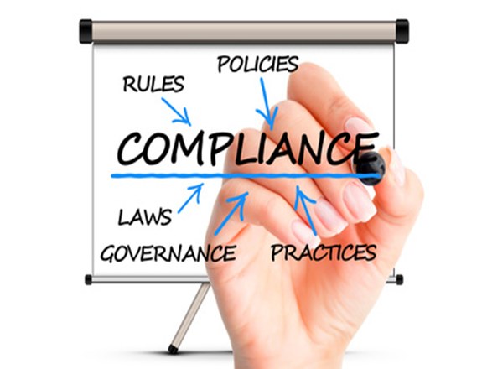
Compliance Programs
A good compliance program is generally:
Clearly documented in writing
Tailored to the business
Know how the business works
Consider activities the company currently does not conduct for potential risk areas
Regularly reviewed/updated
Fully supported by management

Slide 39
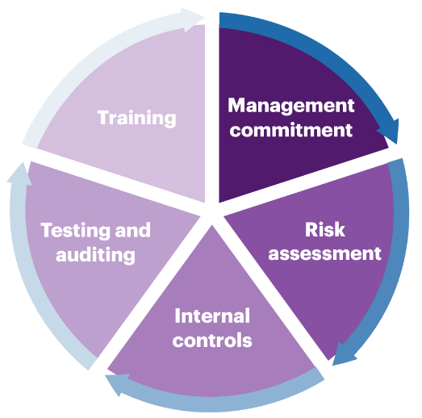
OFAC Guidelines
OFAC Framework for Compliance Commitments
Elements:
Management commitment;
Risk assessment;
Internal controls;
Testing and auditing; and
Training

Slide 40
SCREENING & DUE DILIGENCE

Slide 41
LEARNING OBJECTIVE
Screening transactions, including diligence red flags, end-use/end-user certificates, and the challenges of the 50% rule
SCREENING AGAINST RESTRICTED PARTIES LISTS
ENHANCED SCREENING FOR 50 PERCENT RULE AND END-USER/END-USE CONCERNS

Slide 42
SCREENING TRANSACTIONS
Screening Against Restricted Parties Lists
VARIETY OF LISTS TO SCREEN
Denied Persons List
Entities List
Unverified List
SDN and other OFAC Lists
State Debarment List
Military End User List
Non-Proliferation Sanctions
General Orders under Part 736
Can Use the Consolidated Screening List (CSL) Search: https://www.trade.gov/data-visualization/csl-search

Slide 43
SCREENING TRANSACTIONS
Screening Against Restricted Parties Lists
Why Screen? | Screening Basics
Screening helps protect your company against diversions and possible violations Screening is even more important for transactions not requiring a license | Each export transaction Each new customer Manual screening or Automated systems/services: pros and cons Identify all parties to a transaction Review 10 General Prohibitions, Section 736 of the EAR Look for “Red-Flags”

Slide 44
SCREENING TRANSACTIONS
Screening Against Restricted Parties Lists
Handling Possible “Matches”
Have a procedure for handling matches Do research or request additional information to dispel the match Birth date, address, etc. Take into account common names Contact your screening service for information on lists included in software Document your research and decision

Slide 45
SCREENING TRANSACTIONS
Enhanced Screening
OFAC 50 Percent Rule
Entities owned 50% or more by one or more OFAC sanctioned party (e.g., SDNs) must be treated as sanctioned
Know your customer’s ownership chain, especially in countries with numerous blocked persons
Need to do due diligence on ownership
Web research
Purchase database or service
Consider end user certificate requiring ownership information
Can also apply in non-SDN context (e.g., ownership by more than one SSI entity)

Slide 46
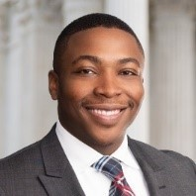
Questions?
Thank you for attending!
Adetayo “Tayo” Osuntogun Partner Adetayo.Osuntogun@btlaw.com (202) 371-6365 |  | Scott Hulsey Partner Scott.Hulsey@btlaw.com (202) 831-6737

